Slide 1
Seq2Seq AI Chat Bot
Submitted By:
ABHISHEK KUMAR (2K19/CO/020) ABHISHEK KUMAR SINGH (2K19/CO/021)
Submitted To:
MR. KAVINDER SINGH

Slide 2
What is a Chatbot ?
Chatbot is a computer program designed to be able to interact with humans through text or voice messages and can answer questions given by humans.
In an ideal world, given a user query in natural language, a bot would respond as follows:
Understand the user's intent;
Retrieve the relevant content from its Knowledge base (KB);
Synthesize the answer and respond to the user (again, in natural language);
Retain the conversation context to answer any follow-up questions by the user.

Slide 3
Usage of Chatbots
In Banking sector, Chatbots are used to handle customer queries (and FAQs) and give guidance on bank services and products. Examples: SIA, iPal and EVA
In Insurance sector, Chatbots are assisting customers in filing claims, getting policies, checking the status of their policies, and locating providers and their branches, as well as other service providers. Examples: Bajaj Allianz’s Boing, Birla Sunlife’s bot and PNB Metlife’s banking applications
In the transport sector, Chatbots are used to provide realtime cab details, flight bookings and verifications, and traffic analysis. Examples: Meru Cab and Yatra.com
In E-Commerce sector, Chatbots have been used in handling queries, tracking orders, making payments and raising customer complaints.

Slide 4
Proposed Work
We have developed a Seq2Seq AI Chatbot. We have implemented encoder-decoder attention mechanism architecture. This encoder-decoder is using Recurrent Neural Network with LSTM (Long-Short-Term-Memory) cells. This chatbot system uses the Python programming language because it is easier to understand. Python has extensive support libraries.
The chatbot system can be used to engage people in small talk and conversation.

Slide 5
RECURRENT NEURAL NETWORKS
Recurrent Neural Network(RNN) are a type of Neural Network where the output from previous step are fed as input to the current step. In traditional neural networks, all the inputs and outputs are independent of each other, but in cases like when it is required to predict the next word of a sentence, the previous words are required and hence there is a need to remember the previous words. Thus RNN came into existence, which solved this issue with the help of a Hidden Layer. The main and most important feature of RNN is Hidden state, which remembers some information about a sequence.

Slide 6
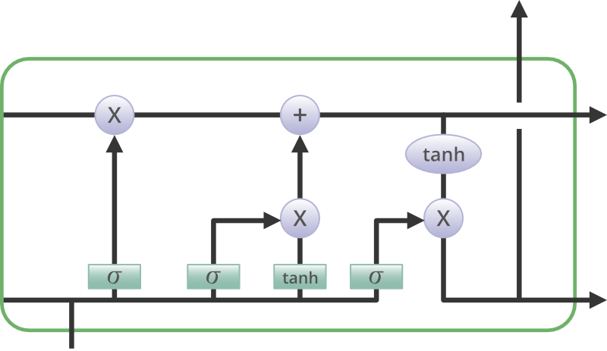
LONG SHORT-TERM MEMORY NETWORKS (LSTM)
Long Short Term Memory is a kind of recurrent neural network. In RNN output from the last step is fed as input in the current step. It tackled the problem of long-term dependencies of RNN in which the RNN cannot predict the word stored in the long-term memory but can give more accurate predictions from the recent information. As the gap length increases RNN does not give an efficient performance. LSTM can by default retain the information for a long period of time. It is used for processing, predicting, and classifying on the basis of time-series data.

Slide 7
SEQ2SEQ MODEL
The sequence to sequence (seq2seq) model is a learning model that converts an input sequence into an output sequence. In this context, the sequence is a list of symbols, corresponding to the words in a sentence. It consists of two RNNs , an Encoder and a Decoder. The encoder takes a sequence(sentence) as input and processes one symbol(word) at each time step. Its objective is to convert a sequence of symbols into a fixed size feature vector that encodes only the important information in the sequence while losing the unnecessary information. Each hidden state influences the next hidden state and the final hidden state can be seen as the summary of the sequence. This state is called the context or thought vector, as it represents the intention of the sequence. From the context, the decoder generates another sequence, one symbol (word) at a time. Here, at each time step, the decoder is influenced by the context and the previously generated symbols.

Slide 8
ATTENTION MECHANISM
One of the limitations of seq2seq framework is that the entire information in the input sentence should be encoded into a fixed length vector, context. As the length of the sequence gets larger, we start losing considerable amount of information. This is why the basic seq2seq model doesn’t work well in decoding large sequences. The attention mechanism was created to resolve this problem of long dependencies. Each time the model predicts an output word, it only uses parts of the input where the most relevant information is concentrated instead of the entire sequence. In simpler words, it only pays attention to some input words.
Attention is an interface connecting the encoder and decoder that provides the decoder with information from every encoder hidden state. With this framework, the model is able to selectively focus on valuable parts of the input sequence and hence, learn the association between them. This helps the model to cope efficiently with long input sentences.

Slide 9
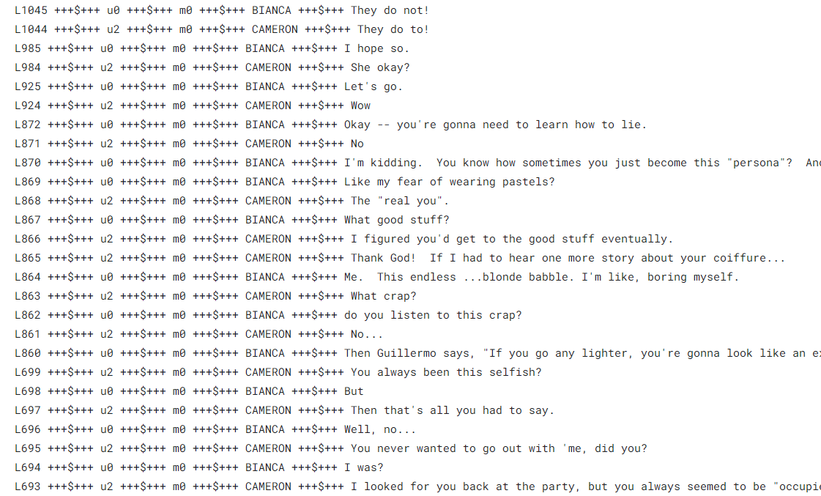
Dataset
movie_lines.txt
- contains the actual text of messages and its response pairs.
This corpus contains a metadata-rich collection of fictional conversations extracted from raw movie scripts:
220,579 conversational exchanges between 10,292 pairs of movie characters
involves 9,035 characters from 617 movies
in total 304,713 utterances

Slide 10
Data Preprocessing
The datasets were cleaned to remove the meta-data (e.g., movie ID, character ID, Line ID) and data separators (“+++$+++”).
Data were separated into two different lists where first list is the dialogue (or questions) and the second one was the response to dialogue (or answer).
Everything except alphabetical character and some punctuation (. , ? ! ’) was removed as they hold little meaning in conversation.
All the text was converted to lowercase.
Multiple consequent occurrences of the punctuations (. , ? ! ’) was reduced to one in order to reduce punctuation overload.
All the punctuation except (’) was separated with a single space before and after for better performance in the Seq2Seq model module.

Slide 11
All the consequent multiple spaces were reduced to single space and each text string was trimmed to remove before and after space.
Data was cleaned for removing extraneous dialogues.
Filter the question and answers that are too short or long.
The most frequent words in the training data were kept as vocabulary.
Additionally, the <PAD> token was used for padding input sequences to same lengths, the <EOS> token was used to signal the end of an utterance and the <UNK> token was used to replace all words not present in the vocabulary. <GO> was given to the start of the sentence.

Slide 12
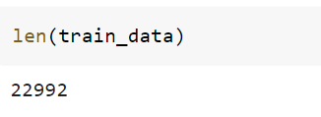

Training
Testing

Slide 13
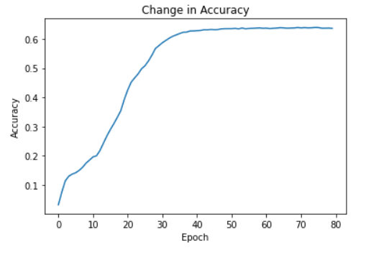
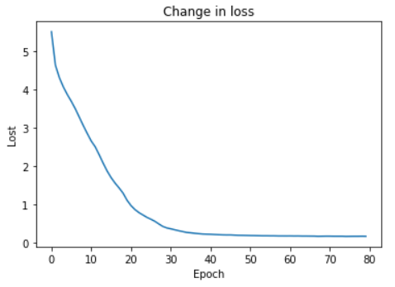
Result

Slide 14
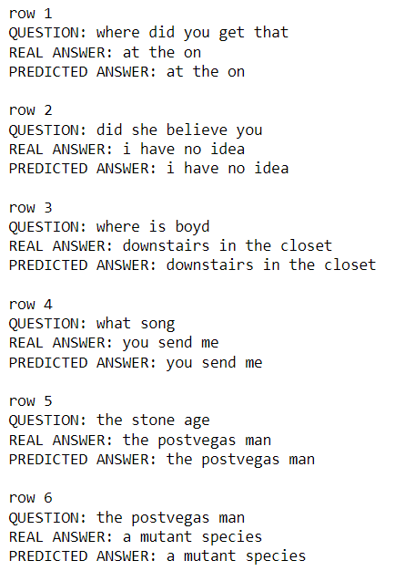
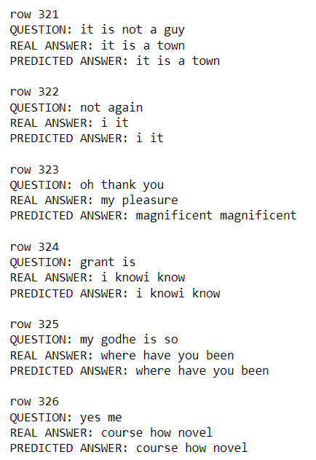
Sample Conversation between User and Bot

Slide 15
Conclusion
We were able to develop a Seq2Seq AI Chatbot. Various techniques and architectures were discussed to make conversational agents more natural and human-like. The performance of the model was analyzed by comparing output responses for a set of source utterances. To get better results, we can try different combination of hyperparameters. We can also try different attention mechanism like Luong.
Many different machine learning or deep learning methods can be explored in order make the chatbot systems more accurate. As a matter of fact, the basic natural language processing tasks can be explored further in order to make the data more suitable for further analysis. Also, the field of processing of unstructured data, which is text data given as a knowledge is yet to be explored in an effective way. So, it can be concluded that there is ample scope for research in this area of natural language processing.

Slide 16
References
Abonia Sojasingarayar, “Seq2Seq AI Chatbot with Attention Mechanism”, Jun 2020
Nitirajsingh Sandu and Ergun Gide, “Adoption of AI-Chatbots to Enhance Student Learning Experience in Higher Education in India”, 2019 18th International Conference on Information Technology Based Higher Education and Training (ITHET)
Rohit Binu Mathew, Sandra Varghese, Sera Elsa Joy and Swanthana Susan Alex, “Chatbot for Disease Prediction and Treatment Recommendation using Machine Learning”, 2019 3rd International Conference on Trends in Electronics and Informatics (ICOEI)
Mohammad Monirujjaman Khan, “Development of An e-commerce Sales Chatbot”, 2020 IEEE 17th International Conference on Smart Communities: Improving Quality of Life Using ICT, IoT and AI (HONET)
https://www.ibm.com/cloud/learn/recurrent-neural-networks

